Slide 1
Don’t touch box
Technical University of
Cluj-Napoca
Bear-O the Bear
Marin Calin
Șereș Ella
Osiac Teodora
Valcauan Adina

Slide 2


The Idea
Initially, the bear is in a state of perpetual relaxation, indulging in carefree dreaming inside its box.
However, if a trespasser happens upon its nest and disturbs its wintery slumber by pressing the switch outside its lair, the bear will promptly creep out and scare off the intruder.
After ensuring that its home is secure, the bear will then press the switch and seals off its lair again, returning to sleep – hopefully undisturbed for the rest of the winter.

Slide 3

How it works
First, the right-hand side button acts as a power button. The device will be inactive until it is pressed.
After the device is turned on, using the left switch, the servos powering the bear and the LEDs are activated simultaneously.
The first servo lifts the lid, while the other one, disguised as the bear’s paw, gets out and reaches for the left-hand side switch.
After this action is performed, the bear gets back inside, the box is closed and the LEDs are turned off.

Slide 4

<code/>

Slide 5
Measurers & Actuators
Arduino Uno
1 action switch
1 power switch
LEDs strip
1 fluffy bear (and two magnets)
1 servo opening the box
1 servo that acts as the bear’s paw
Batteries 4 x 1.5, 1 x 9V
Toothbrush
Wires
Breadboard
Resistors

Slide 6
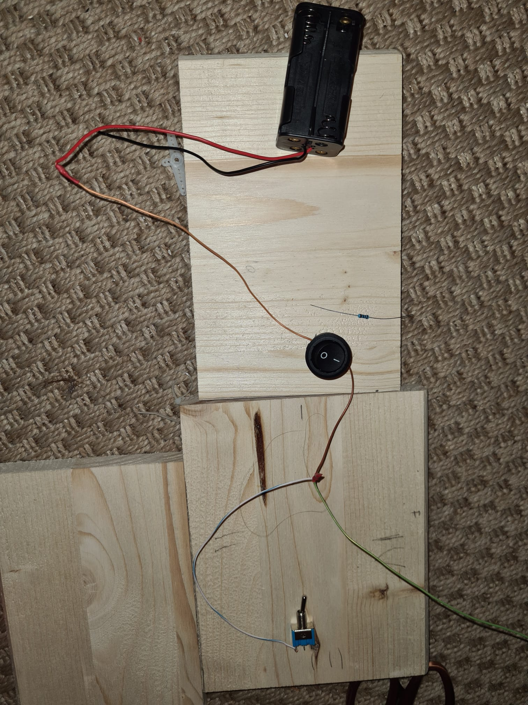
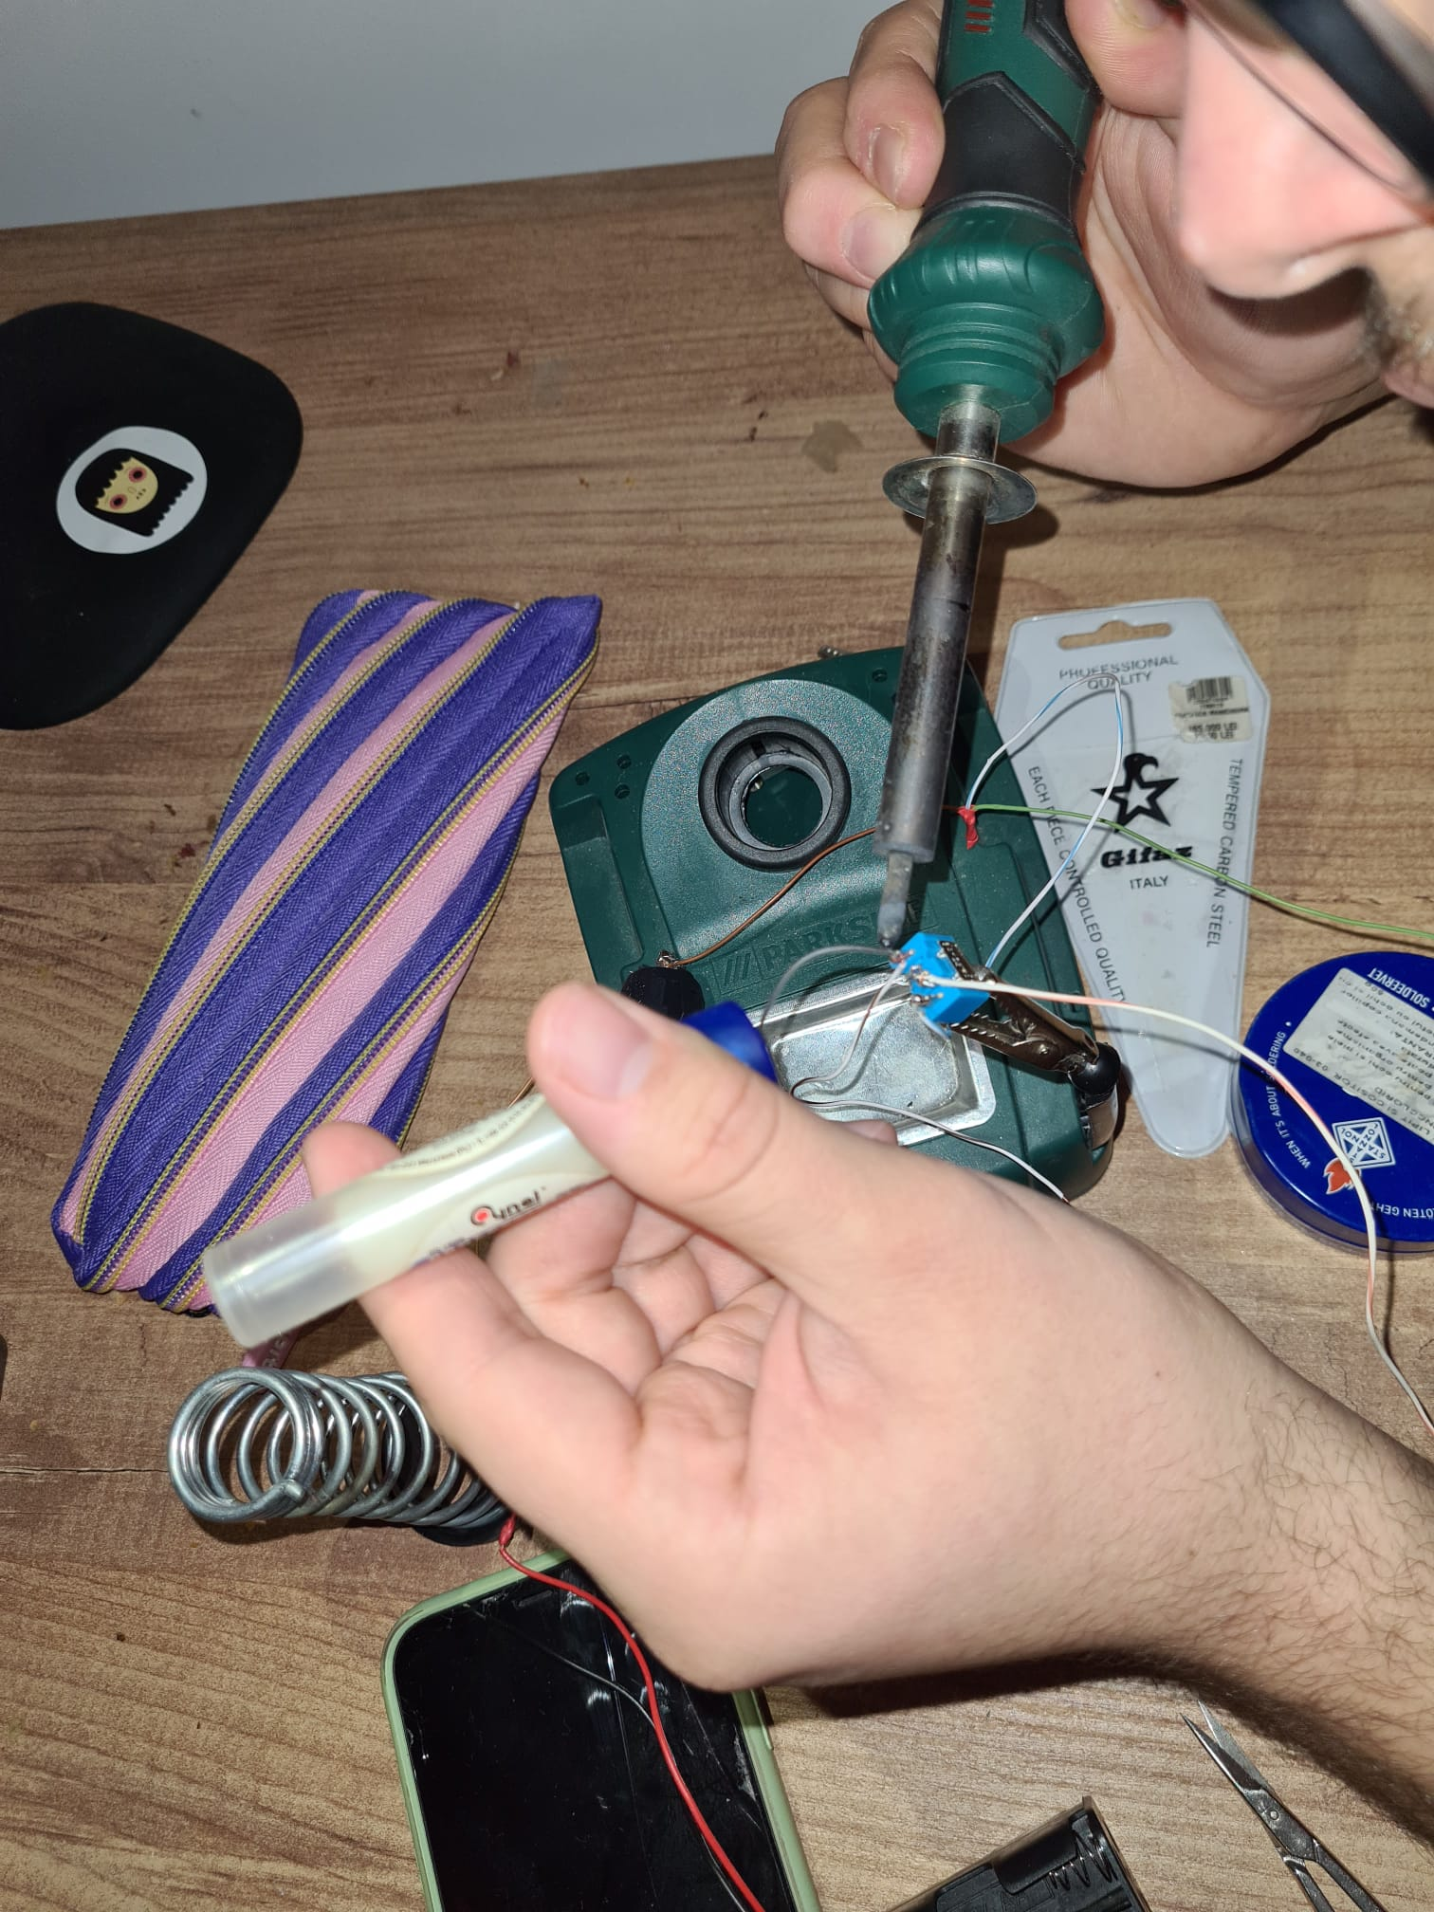
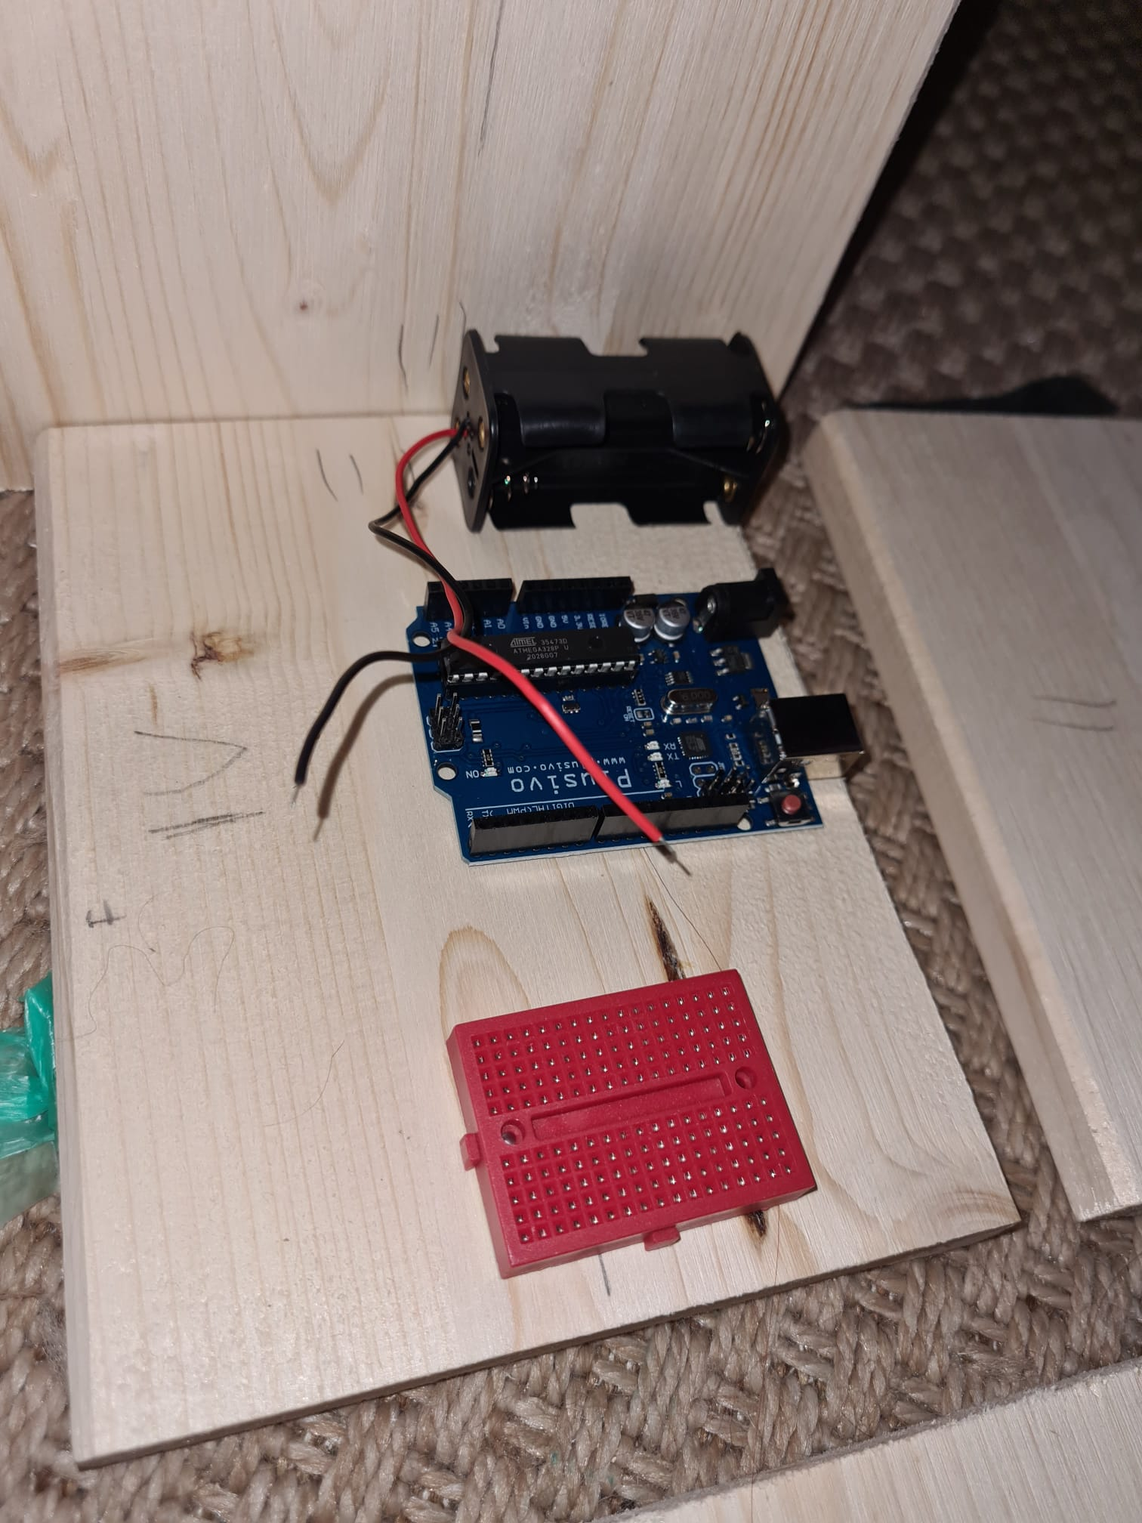
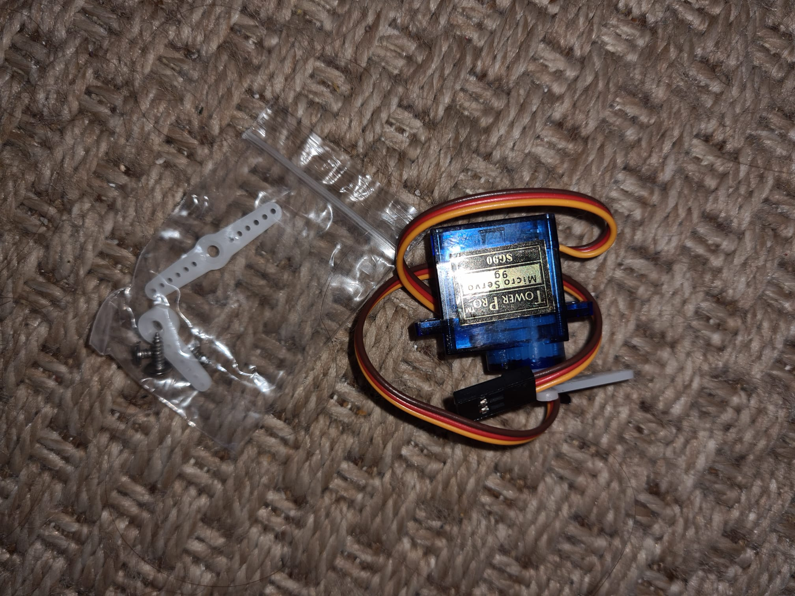
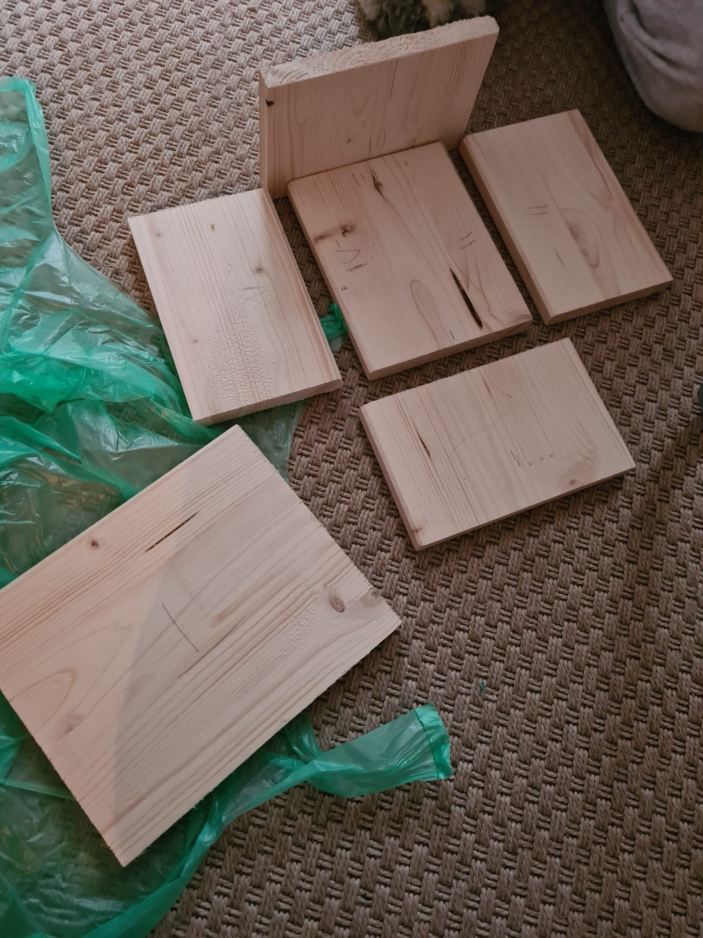
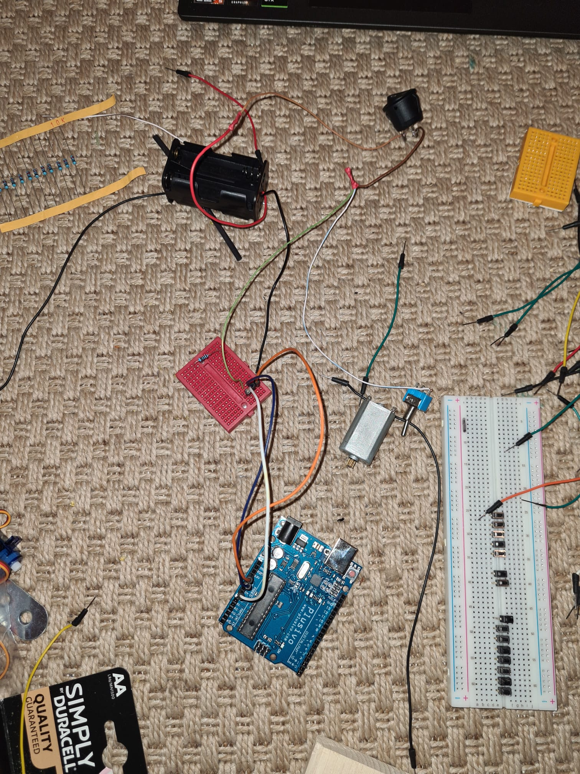
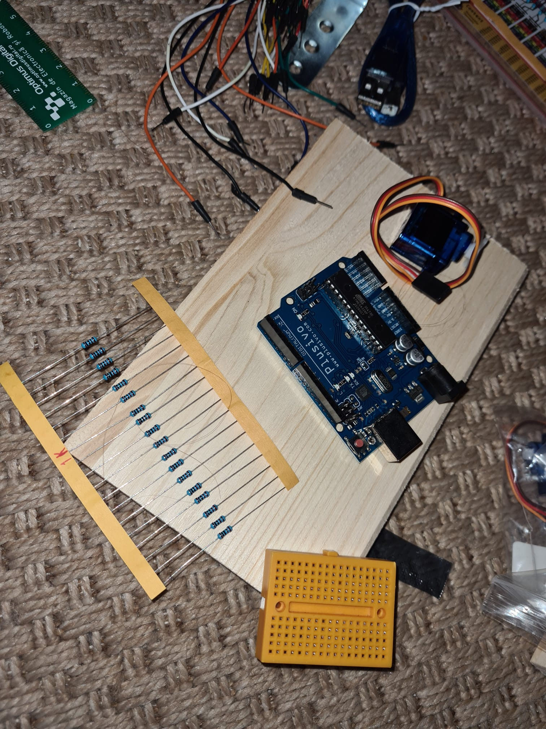
The Process

Slide 7

Difficulties
Faulty initial planning of the circuit overall
The motors were not strong enough compared to the weight of the lid
The switch was too stiff for the motor powering the paw
Finding an internal frame for the paw that reaches out
Powering of the led strip

Slide 8
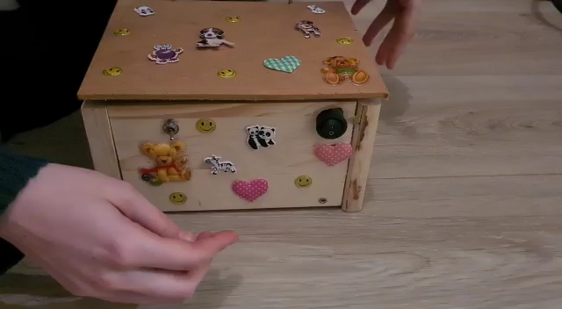
The Result
Video Demonstration

Slide 9

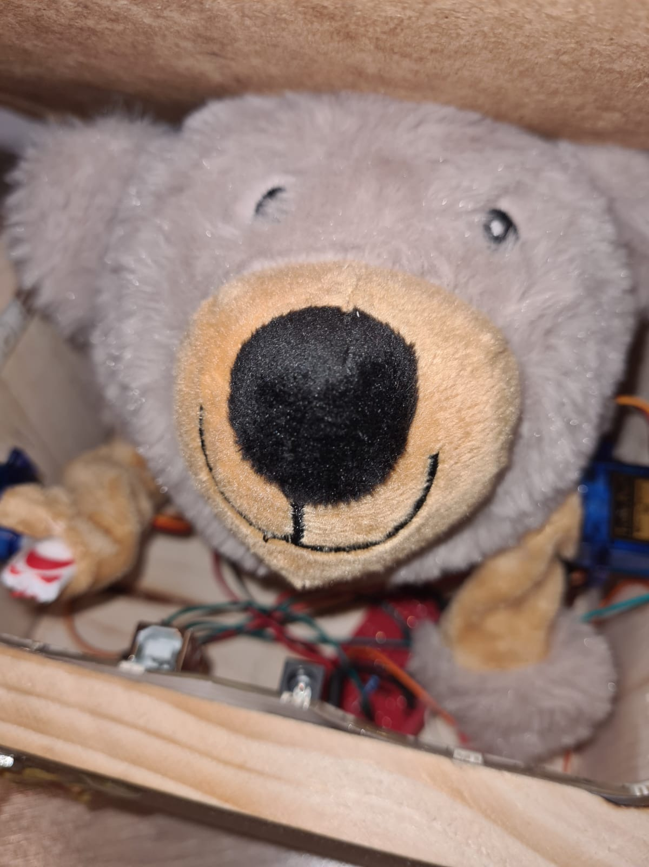
The Team
B - Team
The
A - Team

Slide 10
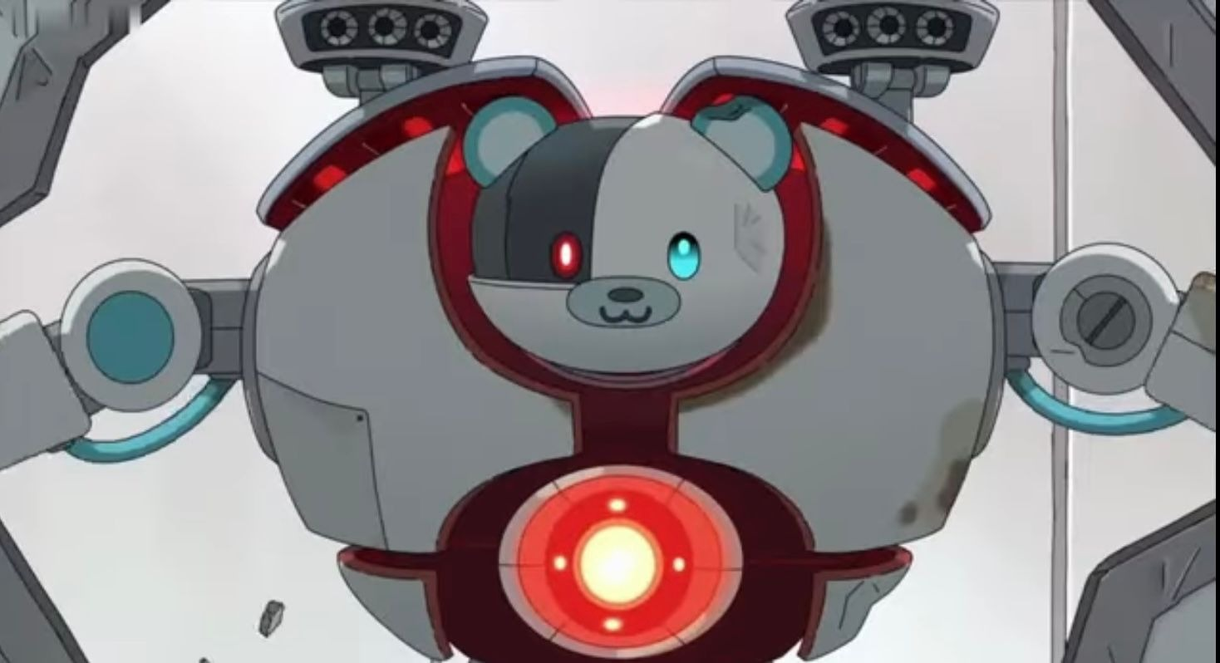
Bear-O thanks you
for your attention

